Slide 1
DAV6100: NYC Service Request &Median Income
Group: Xiaolan Li, Bernard Copper
Professor: Brandon Chiazza

Slide 2
Agenda
Overview
Project Requirements
Data Profile
Conceptual Architecture
Demo
Project Milestones & Timeline
Team Responsibilities
Challenges
Lessons Learned

Slide 3




Overview
Using AWS services to store the Data Resouces
Using My SQL to store the Data Warehouse
Using Tableau to do the Business Analysis
Many data sources
Data Warehouse
Data Visualization

Slide 4
Project Requirements
1. Design, Document, & Plan
3. Test the Solution
Develop a conceptual design architectures
Develop data flow diagrams and data models
Define analytics concepts with bus matrix
Define ETL Instructions
Define data attributes
A prototype is to be test
Break-testing and optimization of the database may be necessary (use of indexes)
Ensure that error-handling scenarios are considered
2. Develop and Build
4. Present and Deliver
Develop the warehouse solution using Amazon Web Services as the platform
Include two data structures:
Structured dataset
Semi/Unstructured dataset
Integrations:
Batch/Migration
Real-time
Data Visualization
Code Repository (GitHub)
Deliver an executive presentation
Demo the architectural components
Demo the visualizations in a data visualization platform like Tableau

Slide 5


Data Profile 1: <<311 Service Request>>
Dataset Summary
<<Show some basic summary statistics in this box. For example, how many addresses exist by zip code or how many terms exists by country. Ok to use a chart or graph here>>
Source of Information | https://data.cityofnewyork.us/Social-Services/311-Service-Requests-from-2010-to-Present/erm2-nwe9
Number of Records | Around 2021 records
Frequency of updates | per day
Data type and structure | Structured Data
Number of columns | 41
Granularity | Service request event with details
Descriptive Statistics
EXAMPLE

Slide 6
Data Profile 2: <<NYC Median Income>>
Dataset Summary
<<Show some basic summary statistics in this box. For example, how many addresses exist by zip code or how many terms exists by country. Ok to use a chart or graph here>>
Source of Information | https://data.cccnewyork.org/data/table/66/median-incomes#66/107/62/a/a
Number of Records | 62 districts, 5 boroughs, 181 zipcodes
Frequency of updates | per day
Data type and structure | Unstructured Data
Number of columns | 5
Granularity | Median income in each location in NYC area
Descriptive Statistics
EXAMPLE

Slide 7
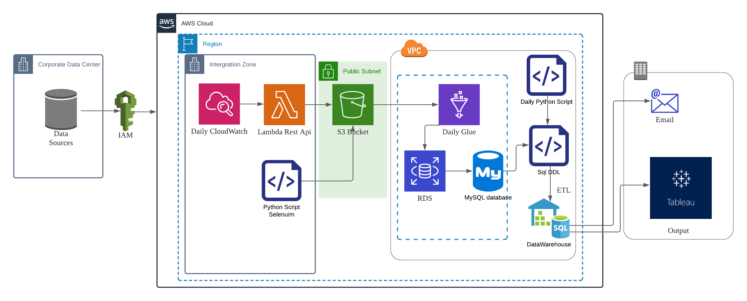
Conceptual Architecture

Slide 8









DEMO

Slide 9





Project Milestones & Timeline
<<07/10>>
<<08/18>
<<Design>>
<<Make the decision of topic and design the architecture>>
<<Impletemt the architechture>>
<<Prepare Scripts and build real time data warehouse via AWS services>>
Deliver & Present
Present final solution to class
Determine peer score
<<Obtain two data sources>>
<<Implement the code to get datascources and load into S3 Bucket>>
<<Business Analysis and Repo>>
<<Doing Analysis from Data Warehouse in Tableau and prepare project repo in github>>
<<06/26>>
<<08/15>>
Week 16

Slide 10
Team Responsibilities
Xiaolan Li
GROUP
Obtained Data Sources, Implement AWS Services, ETL Data Sources to Data Warehouse, Built Github Repo, Presentation
Bernard Cooper
None
Created Research Questions, Obtained Data Sources, Created Data Warehouse, Tableau Data Analysis, Presentation

Slide 11

Assumptions
Instructions:
Describe the assumptions made about your project that contextualize its limitations and constraints.
Feel free to edit/change this slide as much as necessary
1
4
<<describe assumption>>
<<describe assumption>>
2
5
<<describe assumption>>
<<describe assumption>>
3
6
<<describe assumption>>
<<describe assumption>>

Slide 12

Challenges
Lambda Functions with required packages (add whl files to match linux env)
Security group rule when connect the GLUE with RDS (add `All TCP` rule to Sg)
The JOB in GLUE can not detect the columns from data sources
(drop index, rename columns and drop first row in DDL)
Data Sources can’t match a lot district names between services request and median income info (replace the names of districts in median income data source)

Slide 13

Lessons Learned
The following are the key lessons learned from the project.
AWS Services:
S3, RDS, GLUE, VPC, LAMBDA, IAM, CLOUDWATCH
ETL:
Create Data Warehouse
Update dimensional tables
Update fact tables
Notification:
Run SQL DDL
Send email to notice
Tableau:

